Slide 1
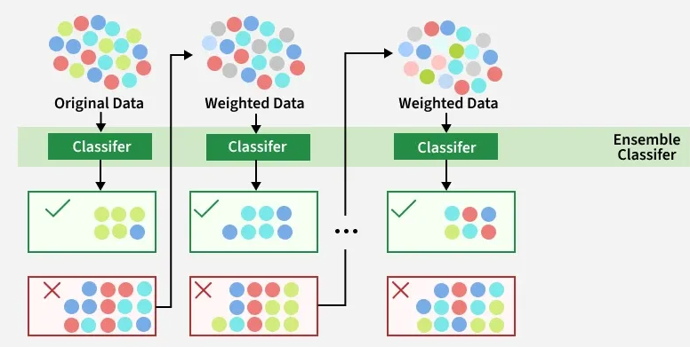
Boosting Algorithm
AdaBoost Algorithm (Adaptive Boosting ):
AdaBoost an ensemble learning technique that combines multiple weak models to create a strong predictive model.
It works by adding the model sequentially to correct the errors made by previous model by adjusting the weight to the misclassified data point.

